Slide 1
FLIGHT PRICE PREDICTOR
By:
Vaibhav Kumar
Roll No : 19

Slide 2
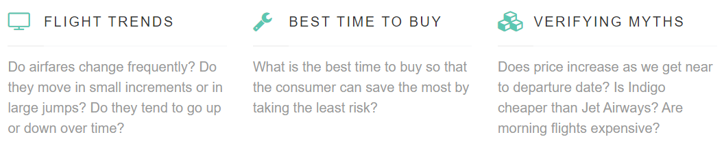
Introduction
Anyone who has booked a flight ticket knows how unexpectedly the prices vary.
Customers have the expectation that they will pay decreased expenses, whereas airlines work to maintain or even increase their overall earnings while also working to improve their profitability.

Slide 3
About Project
Flight ticket price is something hard to guess therefore we are presenting our model which can predict the price of upcoming flight tickets. By using machine learning we are implementing our project. In our project we have created a web page which takes the input from the user. The input contains source, destination, date and the user will select the airline of whose ticket he wants to predict. After giving the input the user can view the result of predicted price which was the result of our model.

Slide 4
Technology Stack
Python.
HTML.
CSS.
Machine Learning.
Bootstrap.
Flask (Framework).
Softwares:
Jupyter Notebook.
VIsual studio code .

Slide 5
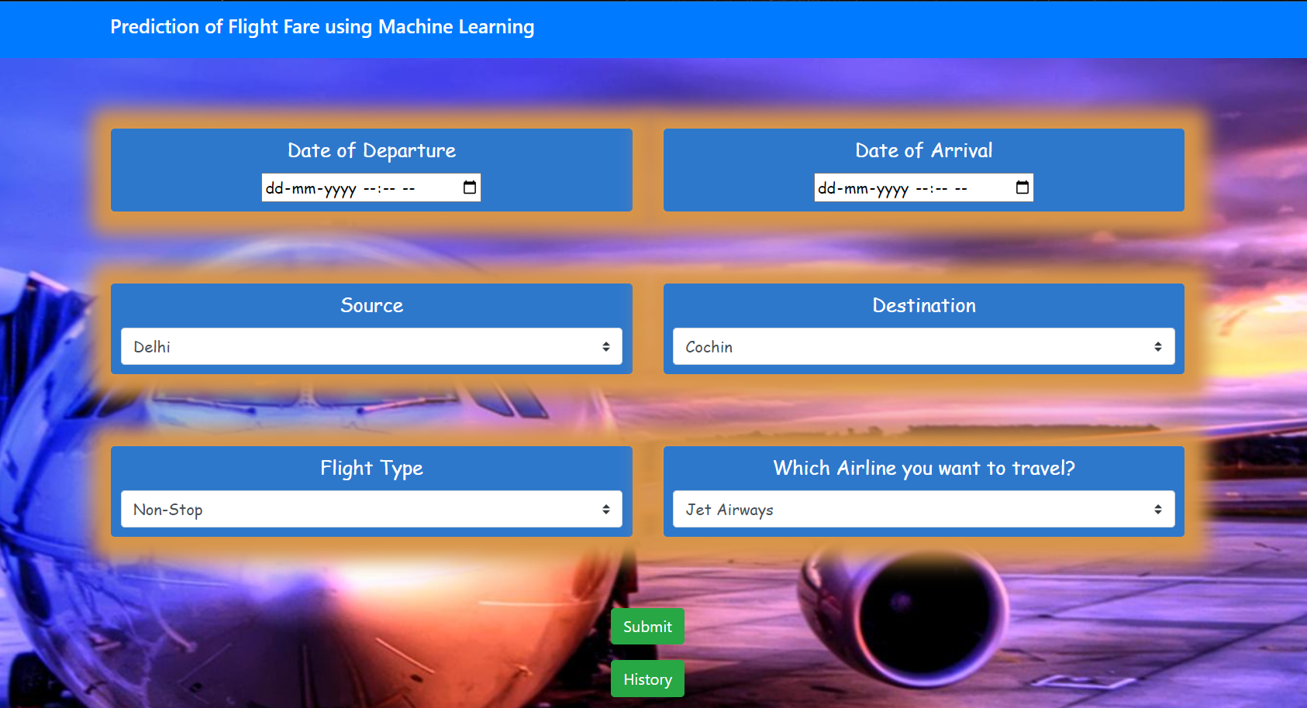

Slide 6
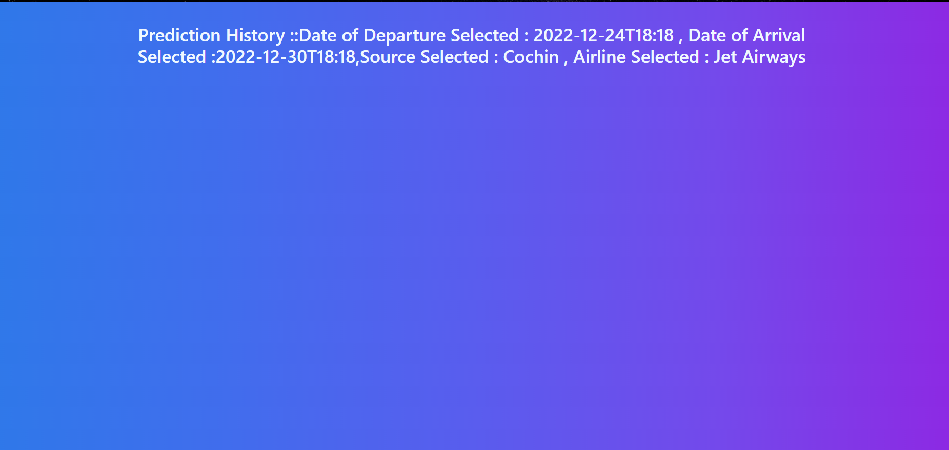

Slide 7
Conclusion
This System, customer can predict the flight price of a day before booking the flight tickets. It will provide an ease to the customer for the flight ticket booking. Travelers can save money if they choose to buy a ticket when its price is the lowest. The problem is how to determine when is the best time to buy flight ticket for the desired destination and period.

